Slide 1
Indian Geography
Economic geography of India

Slide 2
Agriculture
Mines and minerals

Slide 3
Agri
Crop
Land
Fin.
Mkt
Water
M/C
Nutri.
Ext.

Slide 4
Major Crops of India
Rice
Wheat
Pulses
Millets
Oil-seeds
Cotton

Slide 5
Major Crops of India
Sugarcane
Tea
Jute
Spices

Slide 6
Seed Mission
Seed Mission (12th Plan) by Min. of agri
For major 45 crops
To enhance the seed replacement rate (SRR).
To upgrade quality of farm saved seeds
To increase production of certified quality seeds
To establish a seed reserve at regional levels to meet requirement during natural calamities
Up-gradation of public sector seed producing agencies.

Slide 7
Seed Bill, 2004
To Replace seed act, 1966
To regulate production, distribution and sale of seeds
All varieties of seeds for sale have to be registered.
The seeds are required to meet certain prescribed minimum standards.

Slide 8
Seed Bill, 2004
Transgenic varieties of seeds can be registered only after clearance under the Environment (Protection) Act, 1986.
If a registered variety of seed fails to perform, the farmer can claim compensation from the producer or dealer.
Setting up a compensation committee that shall hear and decide these cases.

Slide 9
Agri
Crop
Land
Fin.
Mkt
Water
M/C
Nutri.
Ext.

Slide 10
Land issues: Land size
Large net sown area (~141ml ha)
High pressure on land
Per capita availability of land = 0.32 ha
World avg. = 2 ha
Average operational holding = 1.23 ha

Slide 11
Reasons for Land issues in India
Social system
British policies

Slide 12
Ancient Land Revenue system in India
Symbiotic relation with ruler and farmers
Non-exploitative and non-interference
Akabar’s Mansabdari system- devised by Todalmal – continued till Tuqluq
British dismantled this system

Slide 13
British era: land issues
intermediaries
High land revenue
sun-set law
Money lenders
Bonded labour
Famine-hunger

Slide 14
After Independence: Land Reforms
J.C Kumarappa committee:
Objectives:
Elimination of intermediaries
Tenancy reforms ( security of tenure-ship, ownership rights)
Land consolidation
Modernize land records

Slide 15
Land reforms: agenda 1
Abolition of Zamindaari
Delay in implementation, legal loopholes
Corruption at local level
Informally still exist in some parts of India sp. Eastern India

Slide 16
Land reforms: agenda 2
Tenancy reforms:
Land rent reduced to 10-15%
Security of tenure to tenets through lease or rent-agreements
But lack of land records – no confirmation of ownership of land, illiteracy, poverty in tenets

Slide 17
Land reforms: agenda 3
Land-ceiling:
An upper limit was set for zamindar to keep the land- surplus land taken over by govt.
Benaami transaction, corruption at local level, factious ownership
Lack of computerization of land records

Slide 18
Land reforms: agenda 4
Land consolidation:
Small per capita land holding
Difficulty in profitable, mechanized agriculture
Low productivity, low agro-investment
Exchange of lands to increase operational holding- but mutual trust needed
Cooperative farming - failed

Slide 19
Status of land reforms in states
Not all states can successfully implement the land reforms
Only states like, PN, HN, GJ, MH and southern states partially successful
Farmers in Eastern Indian states still not free from clutches of zamindaars, bonded labour and exploitation of farmers
Farmers of east India – small land holding or landless labourers- high agrarian poverty

Slide 20
Land reforms
British policies
Historic situation

Slide 21
Diversity in Indian agriculture
Agro- status
Farm size
Tech. advancement
Economic status
Landless labour
Big/marginal farmers
Climatic condition
Soil, rainfall
temperature

Slide 22
Agro-climatic Planning
Planning approach for better agro-productivity
Encouraging farming practice which is suitable for local climate and local physiographical situation of the place
FAO definition = a land unit delineated in terms of major climate and growing period, which is climatically suitable for certain range of crops

Slide 23
Agro-climatic regions: parameters
India – diverse climatic conditions
Divisions are based on natural conditions
Climate (rainfall, temperature)
Soil (texture, nutrition, fertility, water holding capacity)
Water availability – surface and groundwater
Terrain – slope/plain

Slide 24
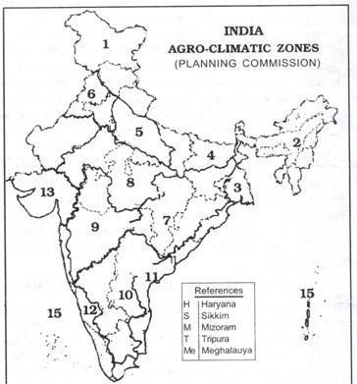
Agro-climatic regions
West Himalayas
East Himalayas
Lower Ganga plain
Mid-Ganga plain
Upper Ganga plain
Trans-Ganga plain
Eastern Plateau and hills

Slide 25
Agro-climatic regions
8) Central plateau
9) Western plateau and hills
10) Southern plt +hills
11) East coast plain + hills
12) East coast + hills
13) Gujarat plains

Slide 26
Agro-climatic regions
14) Western Dry region
15) The island regions

Slide 27
Objectives under Agro-climatic planning
Maximum Productivity
Agro-practices
Technology- research
Conservation of resources
Water-use efficiency
Choice of crops
Economic benefits to farmers
Diversification within agri.
Non-crop options

Slide 28
ICAR: National Agro-research Project
Ecological status
Soil degradation, salinity, GW issues
Socio-economic status
Landless labours, marginal farmers
Bottlenecks to growth
Natural or human induced reasons?
Cropping system
Rainfed farming, shifting agriculture

Slide 29
Agri
Crop
Land
Fin.
Mkt
Water
M/C
Nutri.
Ext.

Slide 30
Irrigation
Present level of irrigation – 63.6 ml ha out of 141 ml ha
India’s 55% net sown area is rain-fed, thus low productivity
To increase productivity, cropping intensity or Gross area production – expansion of irrigation network is necessary

Slide 31
Types of Irrigation in India
Canal irrigation
Tank Irrigation
Tube-well irrigation

Slide 32
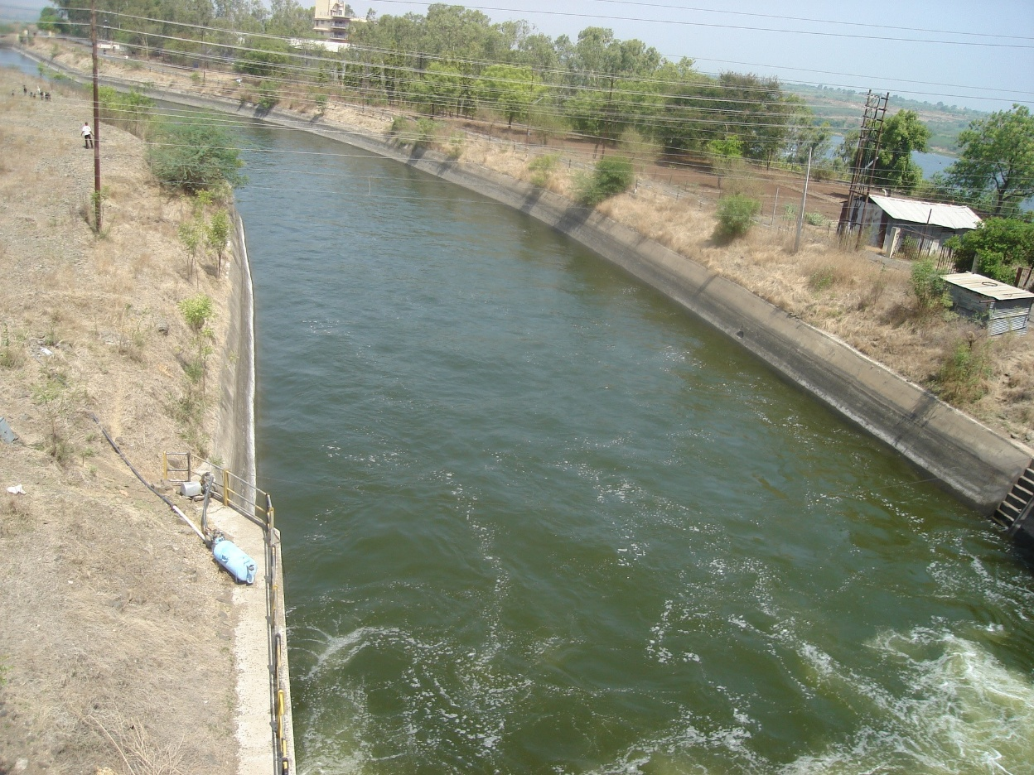
Canal Irrigation
One of the oldest way of irrigation in India
Easy to construct in soft rocks areas – like in northern plains than in peninsular plateau

Slide 33
Canal Irrigation
Multi-purpose river valley projects = drinking water, irrigation, HEP, navigation, fishing
River water storage system = reservoir
Water divergence system = canal
Water application network = small channels
But least efficient irrigation system

Slide 34
Problems of canal irrigation
Efficiency of canal system depend upon dam and its application network
Problems of canals:
Silting
Seepage losses
Evaporative losses
Submergence of lands
Prone to disputes

Slide 35
Under-use of canal waters
Under-use of canal waters
Total installed irrigation potential – 90-100 ml ha but actual usage 70-80 ml ha
Govt. formulated command-area development program to encourage farmers to use canal waters

Slide 36
Reason for under-usage of canals
Problems of water supply in canals
Not all farmers can construct field application channels from the canals (small land, poverty, tech)
To use canal water needs, field- leveling and field grading
Lack of warabandhi irrigation system

Slide 37
Command area dev. Prog.
Development of on-field activities (field-channels, field leveling, field-grading)
Supply of improved seeds, fertilizers, pesticides, improved methods
Agro-credit and services
Post-harvest infra (cold storages)
Forming of “Paani-panchayats”- to resolve water issues

Slide 38
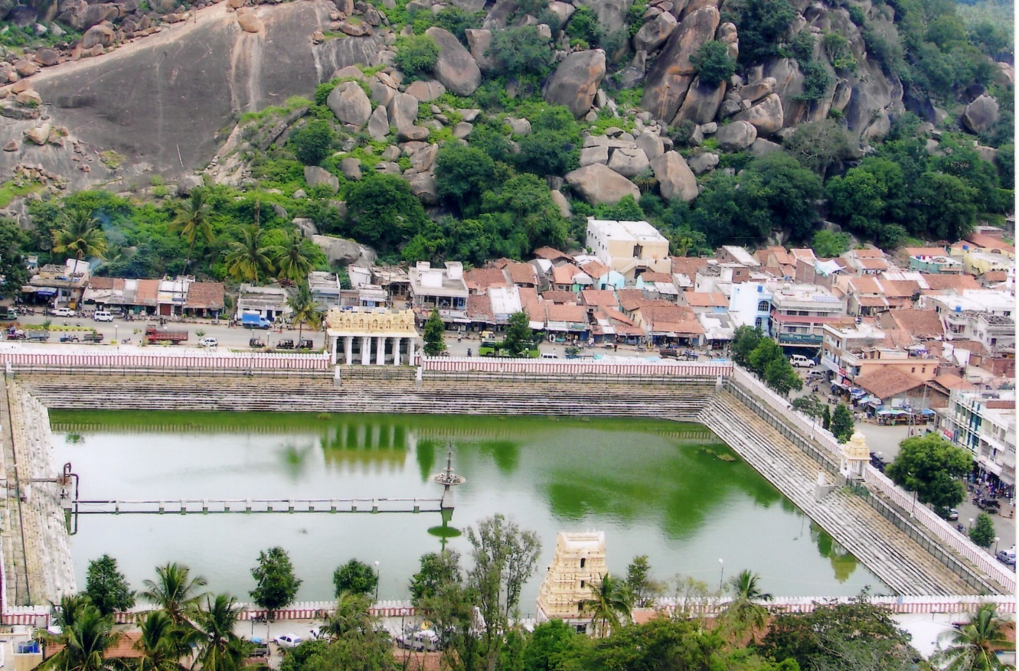
Tank irrigation
Artificial ponds of massive size
Up to 3-4 acre of area
Popular in southern India / peninsular plateau
Temple town in south India

Slide 39
Tanks in south India
Difficult to construct canals in hard rocks of peninsula
Ancient practice to tank in south India
Common tank among the temple town
Small channels to agriculture fields
Locally constructed and managed
But dry, semi-arid regions:
Susceptible to evaporative losses

Slide 40
Decline of tank irrigation
Construction of massive tanks declined
Farmers of arid, semi-arid regions –poor (rain-fed farming)
Construction and maintenance of tanks costly
Ignorance to traditional practice

Slide 41
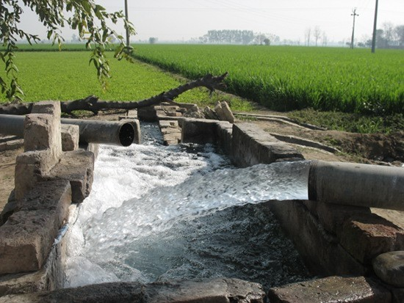
Tube wells
Most convenient, cheap method where rainfall is less or not reliable
No evaporative or seepage losses
No need of application network

Slide 42
Problems with Tube-wells
Tube –wells give false sense of surplus – misuse of ground water
Electricity, tube wells on subsidy
Lowering water table
Over-use of ground water –soil salinity

Slide 43
Status of various irrigation techniques
Irrigation techniques | 1950-51 | 2009-10 | status
Canals | 40% | 30%
Tanks | 15-17% | <4%
Tube wells | 30% | >60%

Slide 44
Rain water Harvesting
Watershed management
Drip-irrigation
Sprinklers
Mulching

Slide 45
New Schemes for Irrigation development
Neeranchal
Watershed development in country
Pradhan Mantri Krishi Sinchayee Yojana
Expedite stalled small and major irrigation projects

